Slide 1

JSON Seminar
Computer Science Project I
Course 2023/2024

Slide 2
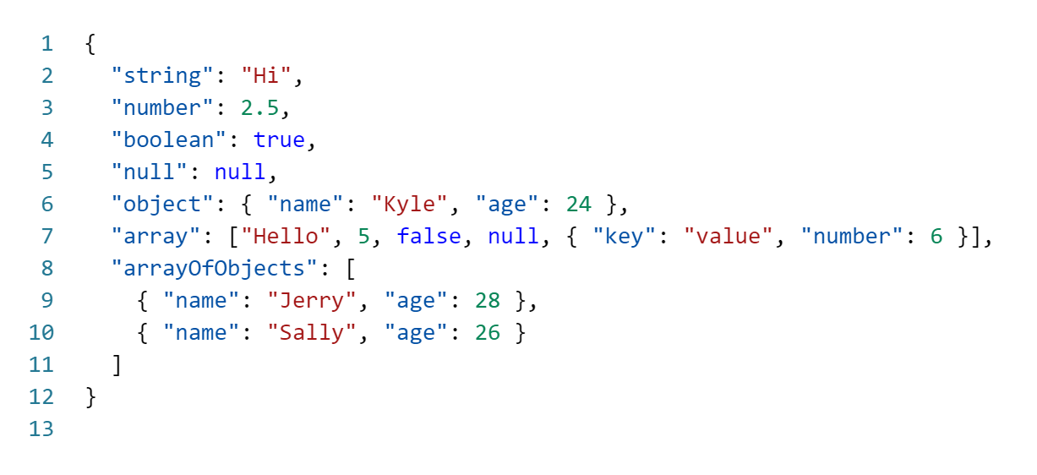

What is JSON?
JSON is a simple text format for data exchange.
Although it is unique to JavaScript, it is considered a stand-alone format.
Facilitates future migration to DB in S2.

Slide 3
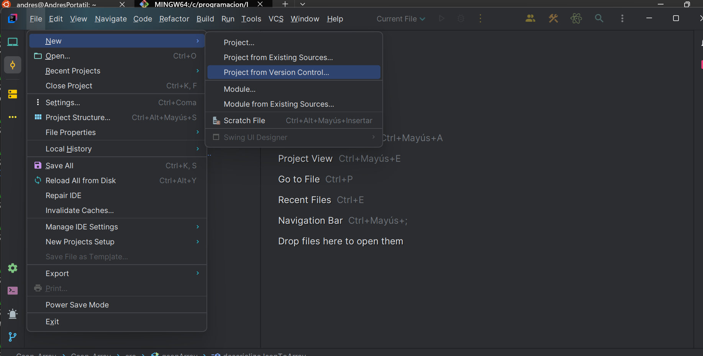
Content in GitHub https://github.com/agorosti/JSON-Example

Slide 4
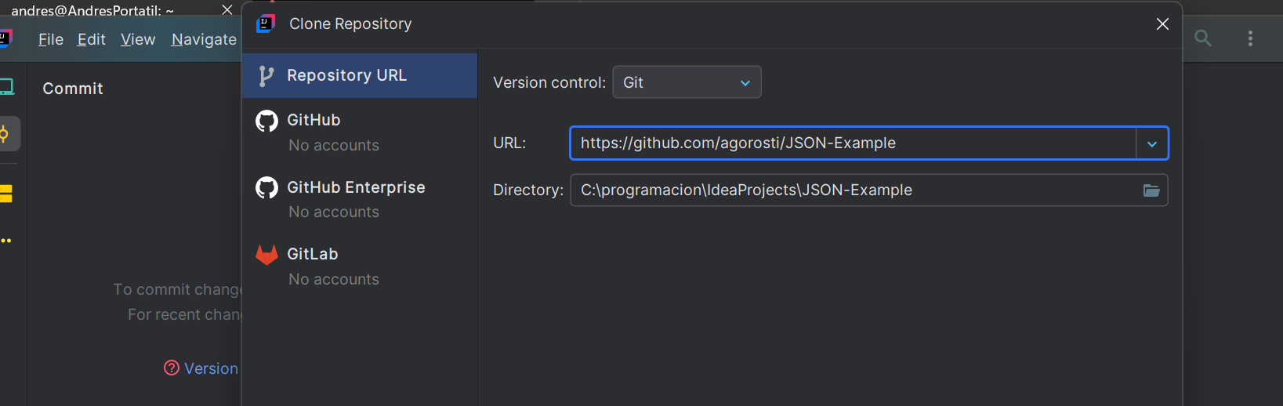
Content in GitHub https://github.com/agorosti/JSON-Example

Slide 5
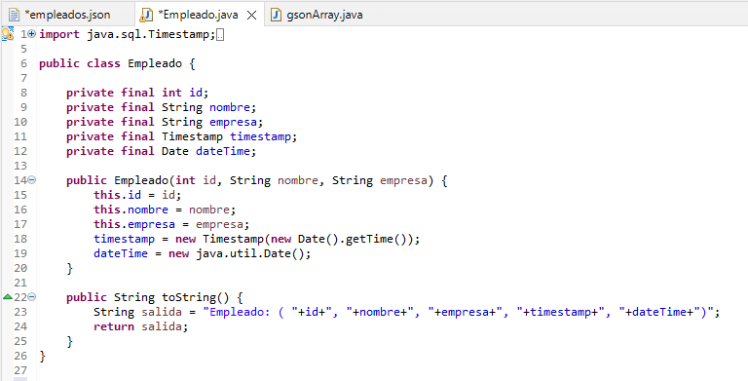
GSON_Array
Employee.java

Slide 6
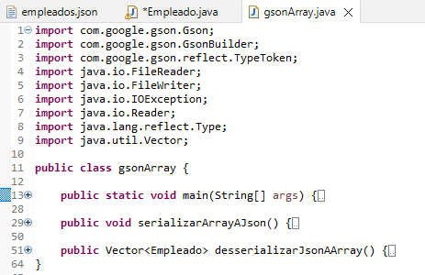
GSON_Array
gsonArray.java

Slide 7
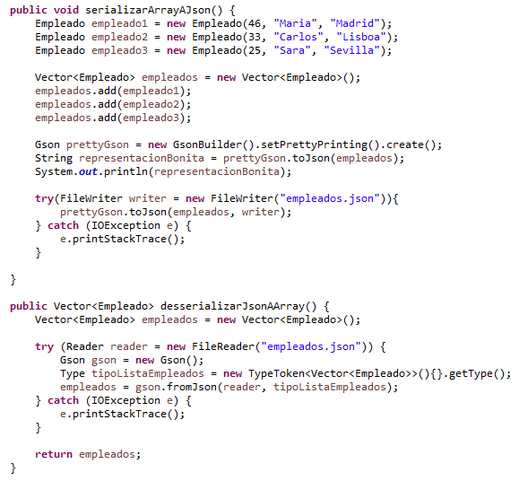
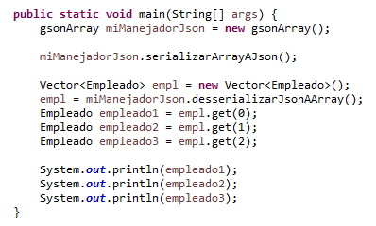
GSON_Array
gsonArray.java

Slide 8
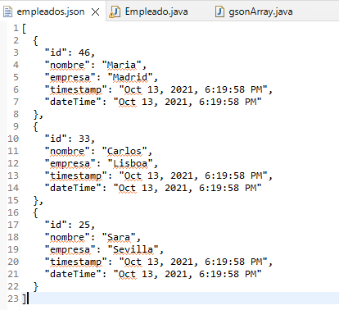
GSON_Array
employees.json

Slide 9
Practical exercise
Based on the example project, the following is requested:
Adding new employees to the json without deleting existing ones
In Main, instead of printing each employee by console, print only the employee's name
From a copy of the sample project, the following is requested:
Create a user model instead of an employee, with the data you consider (think about your application).
Create users.json with at least 5 users

Slide 10
JSON Seminar
Computer Science Project I
Andres Gorostidi
Andres.Gorostidi@universidadeuropesa.es

